Slide 1
Preliminary evaluation of RAL3 science
Belinda Roux, Charmaine Franklin, Chun-Hsu Su, Greg Roff, Vinod Kumar
Bureau of Meteorology
ACCESS SCIENCE DAY
11 June 2021

Slide 2
Background
Regional Model Evaluation and Development (RMED)
shared activity of the UM Consortium
focussed on understanding and improving convective-scale model
RAL3 (Regional Atmosphere and Land)
Aim to unify as much as possible tropical and mid-latitude model configurations
Currently testing 3 packages:
RAL3M: All RAL3 Tickets (Bimodal cloud scheme and land surface consolidation + others)
RAL3T_p1: Same as RAL3M but without mid-lat stochastic boundary layer temperature & moisture perturbations
RAL3T_p2: All RAL3 tickets except Bimodal cloud scheme - using existing PC2 cloud scheme instead

Slide 3
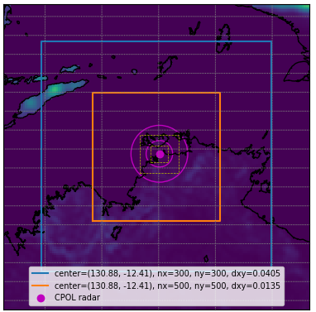
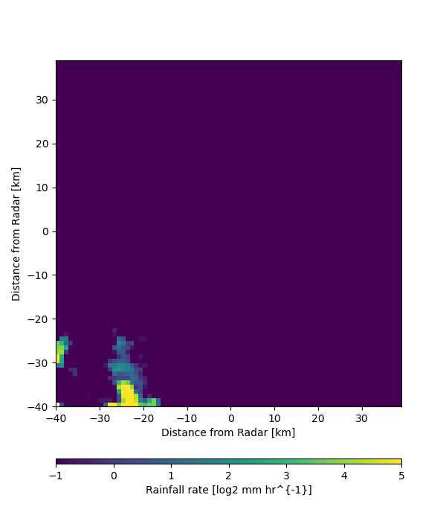
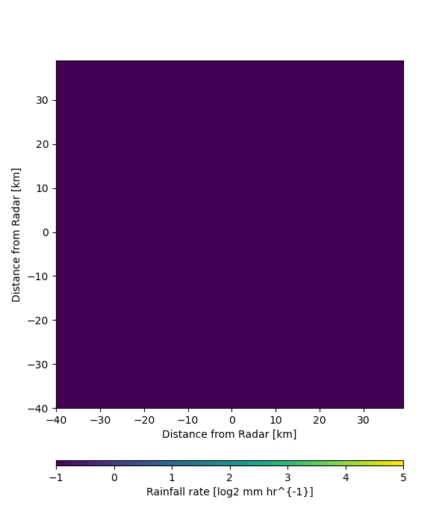


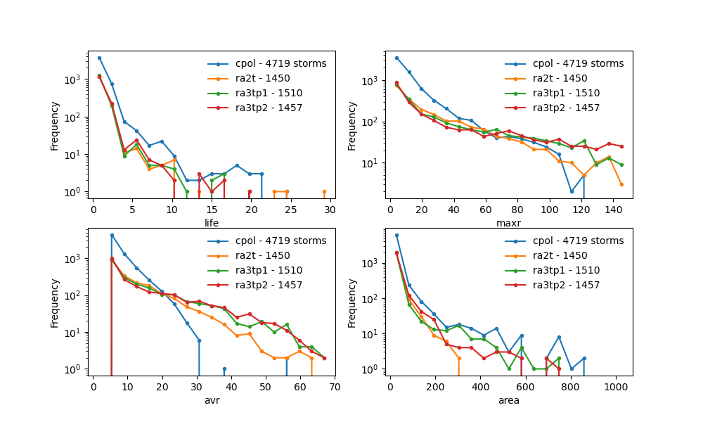
RAL3 packages for convective storms over Darwin, 2012-2017
4.5km
2017/3/30 10:20 – 2017/3/31 19:30
CPOL RA2T RA3T Pack 1 RA3T Pack 2
1.5km
CPOL
Preliminary results based on 6 cases
Storm cell life [#10min steps]
Storm-area averaged rainrate [mm/h]
Chun-Hsu Su, C. Franklin (BOM), V. Louf (BOM), T. Stein (Reading)
Notes:
The assessment of RAL3-tropical science configurations are being assessed over Darwin, with particular attentions to a sample of 30+ convective storm events between 2012 and 2017.
There are two possible RAL3 configurations under assessment here, RA3T Package 1 and Package 2. They are compared against RAL2.
Here the Darwin CPOL radar derived rain rates and 3D reflectivities will be used to look at storm cell statistics and storm morphology.
The work is still underway to look at storm morphology with reflectivity data, but here shows the early results of comparing the storm cell statistics.
The simulated rain fields are analysed to distinguish individual storm cells and tracking these storm cells over their lifetime.
This allows us to compare the models in terms of the longevity of storm cells, and also storm-area averaged rain rates.
Here we find that there are still some significant differences between the models and observations.

Slide 4
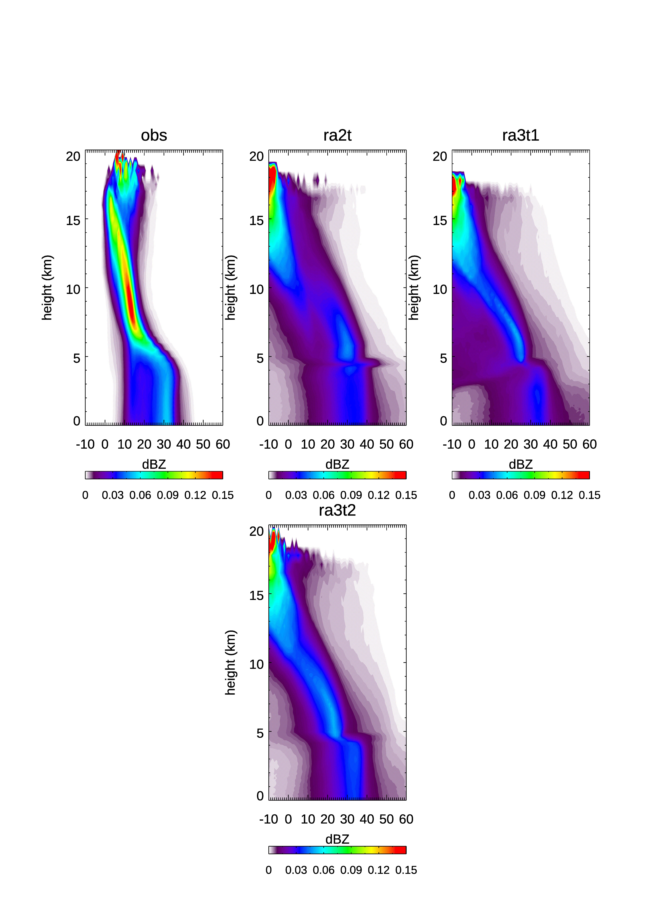
Radar reflectivity distributions with height Darwin Mesoscale Convective System
Charmaine Franklin
Notes:
- These are called CFADS (Contoured frequency with altitude diagrams of radar reflectivity), basically independently calculated PDFs at each height
- All simulations have too wide a distribution compared to the observations, particularly ra3t1 below 8km, ra3t2 has improved on ra2t and is narrower (although it does have more very large reflectivities below 3km and associated higher max rain rates)
The reduced discontinuities seen in ra3t is an improvement over ra2t, however, all simulations still underestimate the peak occurrence seen in the observations at 8-9km
Cloud top heights higher in ra3t2 and this is an improvement over ra2t but reflectivities are too low: obs above 18km have cloud ~10dBZ whereas ra3t2 is between -10 and 0 dBZ, which means this high cloud in ra3t2 does not contain enough ice water content and larger ice particles
Overall, the most realistic looking simulation is ra3t2

Slide 5
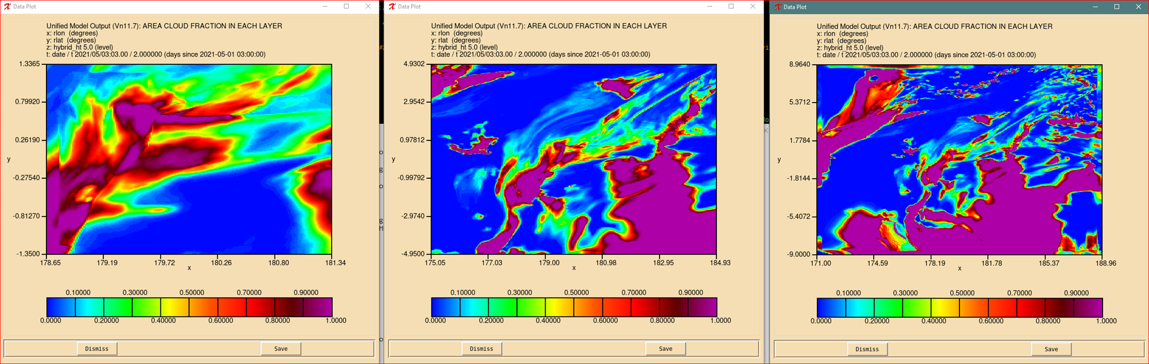
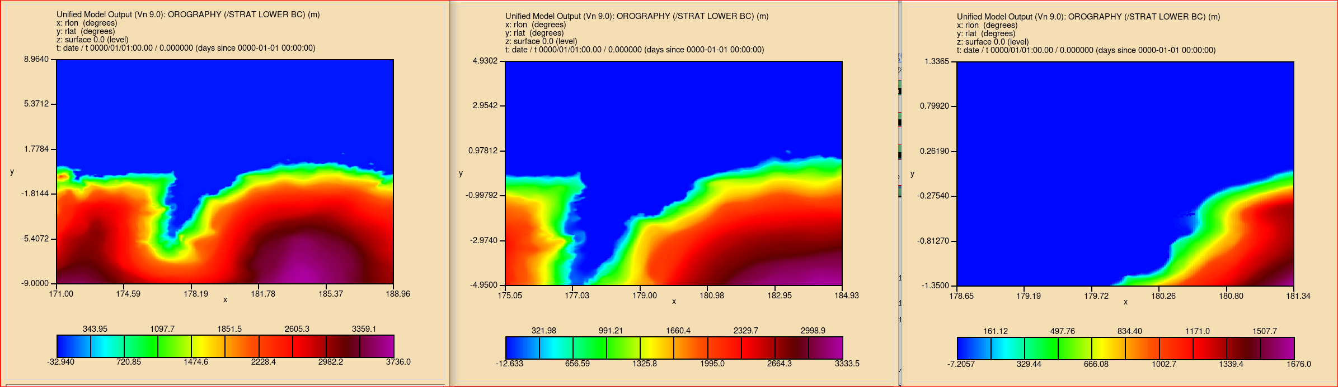
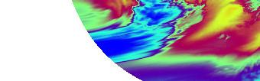
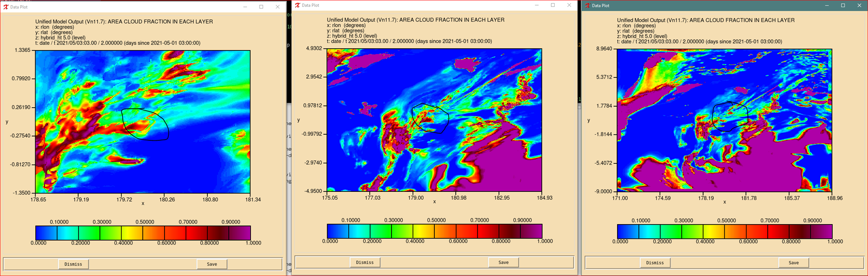
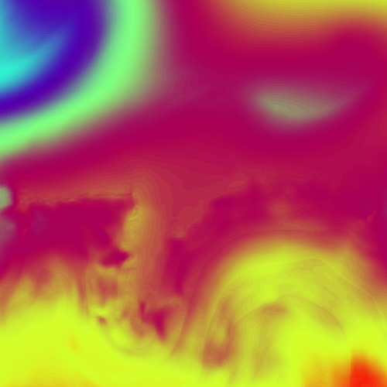
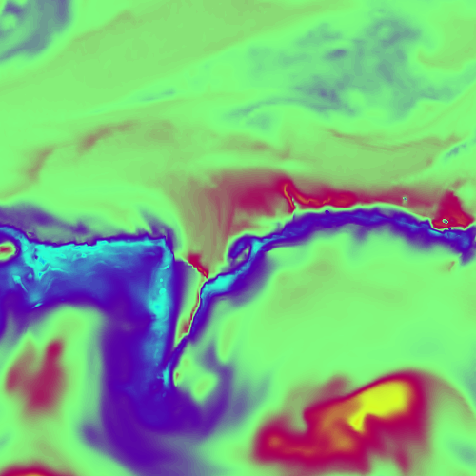
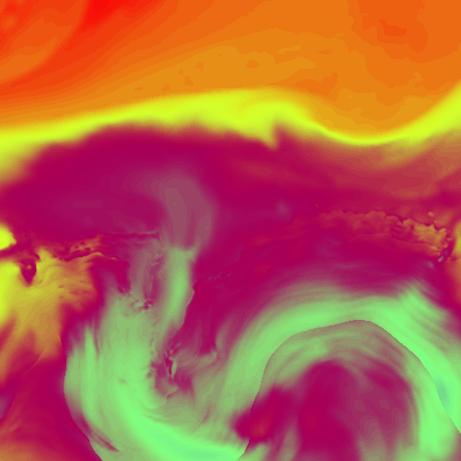
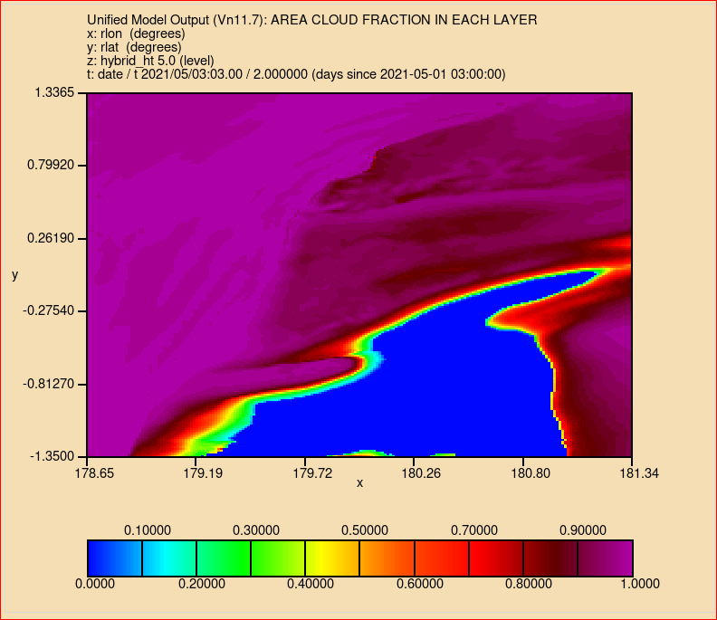
Area cloud fraction
RA2M-davisA-ral3ish comparison: first results
Greg Roff and the AMT team
std RA2M=true
20210501T0300Z: Ht, rh, temp - RA2M resn_1 nesting 4km centred on Davis
G3 ic 48hr fcst, 1000 plev, 3hrly. Also have same for nest_2 and 3 at 2+1.5km
Orog
RA2M+#83
Himawari
ht
rh
temp
RA2M+PC2
Notes:
RA2M-davis suite is located over Davis Base; RAL3 anc for polar regions is unavailable at present; so ran (1) 3xnesting RA2M-davisA-ral3ish suite with Standard RA2M =true; then (2) cp this suite to RA2M-davisA-ral3ish0 and added just the RAL3 #83 changes and also (3) cp to RA2M-davisA-ral3ish0a and added the PC2 cloud scheme
Left panel shows animations of Ht, rh, temp from standard RA2M resn_1 nesting (4km) centred on Davis Base using: G3 ic , 48hr fcst, at 1000 plev and 3hrly interval. Synoptic scale systems seem realistic for the orography of the area (also shown on the right); and seem to be somewhat similar to the Himawari sat fog imagery at the top – note limited coverage.
Right panel show Area Cloud Fraction for: Top - RA2M-davisA-ral3ish [std RA2M=true]; Middle - RA2M-davisA-ral3ish0 [RA2M+#83]; Bottom - RA2M-davisA-ral3ish0a [RA2M+PC2]
The three suites have unchanged Surface fields (not shown) as expected) but Cloud fields are very different (also as expected). The #83 changes seem to make the most realistic impact at all nesting stages – RA2M+#83 = goldilocks result?- while the PC2 run Area Cloud Fraction seems overdone.
Next will run in RES suite to verify differences.

Slide 6
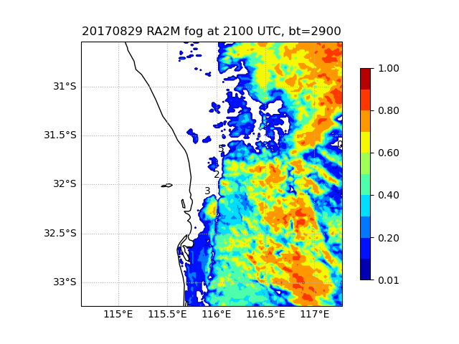
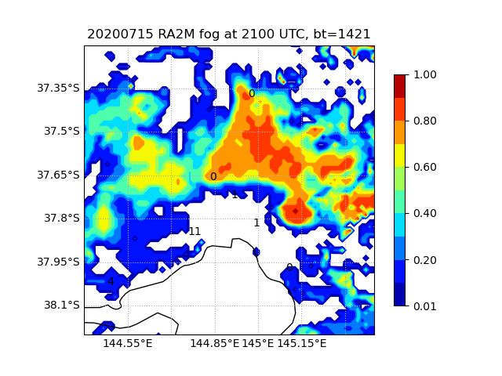
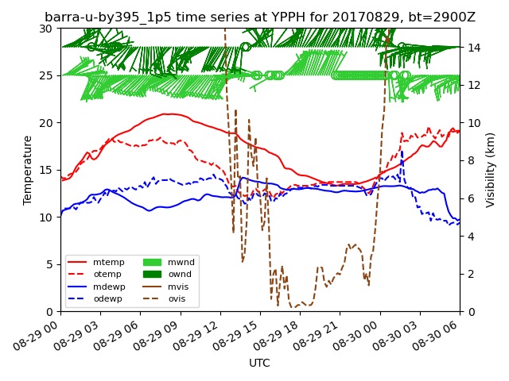
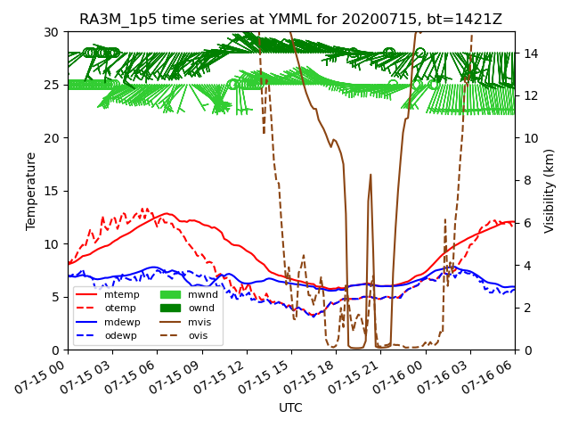
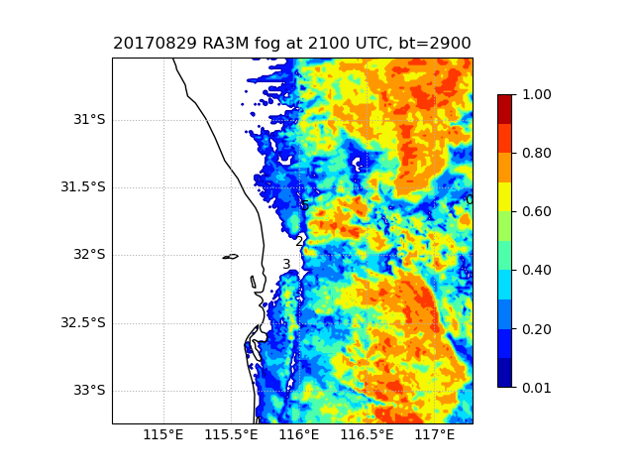
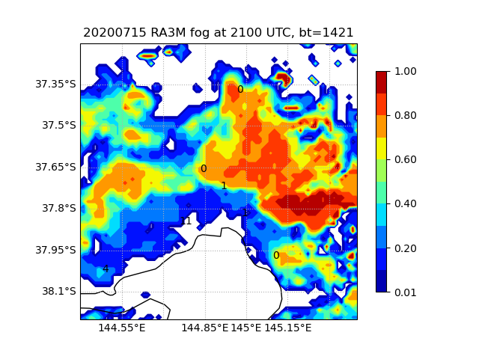
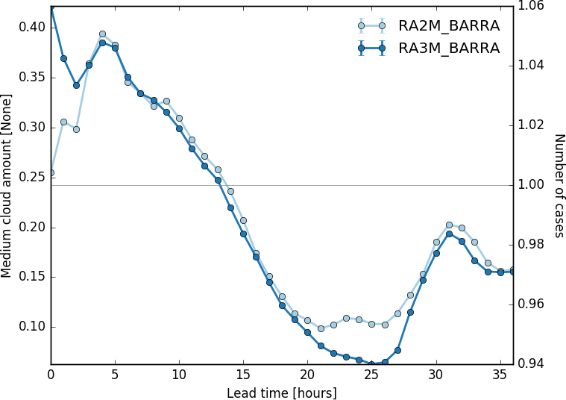
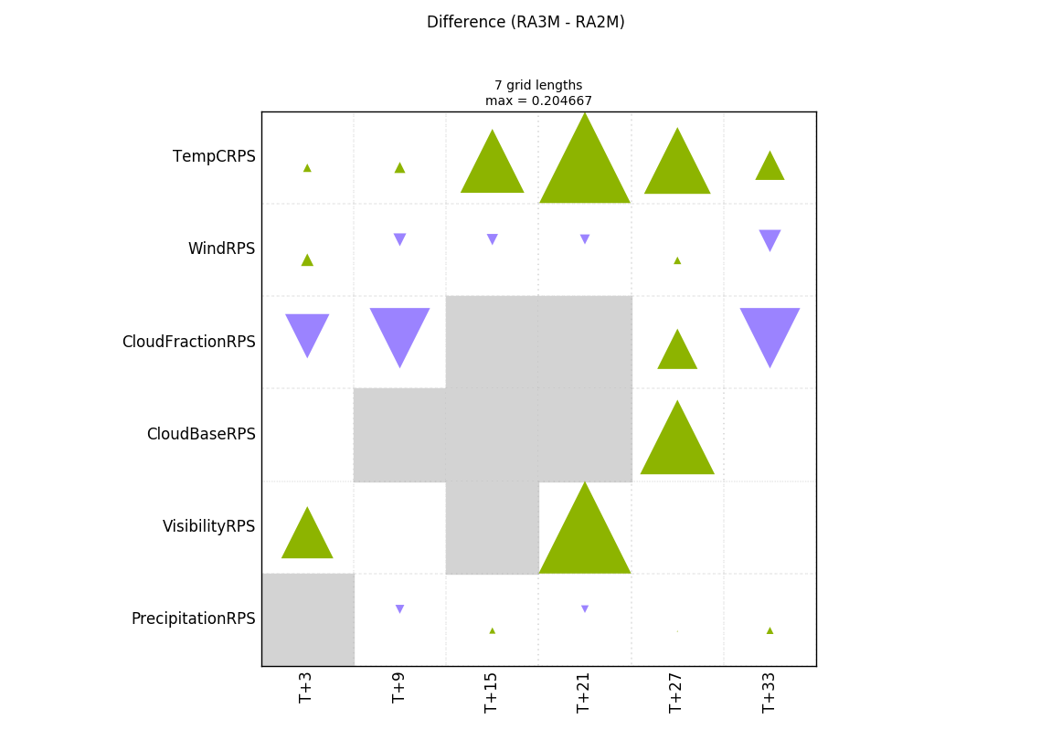
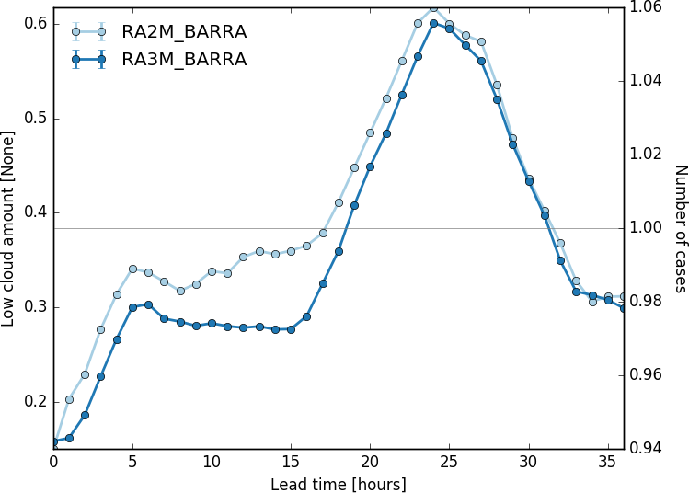
Fog case studies: Perth and Melbourne Airports
Perth
Melbourne
RAL3M more fog than RAL2M (RAL2M more cloud)
Both Airports (and configs) overestimate evening scrn temp in urban areas – under investigation
Med cloud
Low cloud
Belinda Roux

Slide 7
Type of testing | Weather type | Domain | Owner | Resolution
Case study | MCS | Darwin - T | Charmaine Franklin | 1.5km, 400m
Case study | Squall line | Darwin - T | Charmaine Franklin | 1.5km, 400m
Case study | Fog | Perth - M | Belinda Roux | 1.5km, possibly 300m
Case study | Fog | Melbourne - M | Belinda Roux | 1.5km
Case study | Supercell | Sydney - M | Hongyan Zhu | 1.5km
Case study | Polar weather | Davis, Antarctica | Greg Roff | 1.5km
Storm tracking ~35 cases | Tropical convection | Darwin - T | Chun-Hsu Su | 4.5 and 1.5km
Short DA trial | Tropical summer | Darwin - T | Susan Rennie | 1.5km
Ensemble case study | Tropical convection | Darwin - T | Shaun Cooper | 2.2km
RAL3 testing plans

